Slide 1
Computer Network (CS3002)
Spring Semester (2021-2022)
Dr. Judhistir Mahapatro
Department of Computer Science and Engineering
National Institute of Technology Rourkela

Slide 2
Introduction to Computer Networks (Lecture-1)

Slide 3
Organization of this Lecture:
Introduction to Computer Networks
Applications
Network Hardware
LAN, WAN, MAN
Protocol Hierarchy
Standards
Summary

Slide 4
Computer Networks
A large computer (placed in a room) to which users bring work for processing is now totally obsolete.
  A single computer serving all of the organization’s computational needs
Replaced by one in which a large number of separate but interconnected computers do the job. These systems are called Computer Networks.

Slide 5
Computer Networks
It is a collection of autonomous computers interconnected by a single technology.
Two computers are said to be interconnected if they are able to exchange information.
The connection need not be via a copper wire;
  fiber optics, microwaves, infrared, and communication satellites can also be used.

Slide 6
A Distributed System vs Computer Networks
A distributed system is a collection of independent computers appears to its users as a single coherent system.
A middleware (often a layer of software on top of operating system) is responsible for such single model or paradigm.
    Example: World Wide Web, it runs on top of Internet and presents a model in which everything looks like a document (Web page).

Slide 7
A Distributed System vs Computer Networks
In computer networks, this coherence, model and software are absent.
Users are actually exposed to the actual machines
  if a user wants to run a program on a remote machine, he has to log onto that machine and run it there.
  Different hardware and operating systems are visible to the users.

Slide 8
A Distributed System vs Computer Networks
In effect, a distributed system is a software system built on top of a network.
The distinction between a network and a distributed system lies with the software (especially the operating system), rather than with the hardware.
  Example: They both need to move files around. However, the difference lies in who invokes the movement, the System or the User.

Slide 9
Computer Network
Network
Source
Destination

Slide 10

Computer Network?
“interconnected collection of autonomous computers”
What is the Internet?
  “network of networks”
  “collection of networks interconnected by routers”
  “a communication medium used by millions”
  Email, chat, Web “surfing”, streaming media
Internet Web
Distributed system

Slide 11
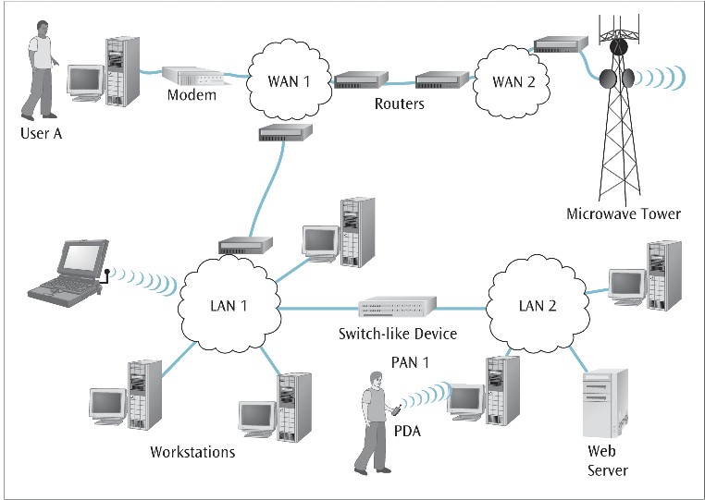
The Big Picture of Networks

Slide 12
Why network?
Before networks:
  One large computer (mainframe) used for all processing in businesses, universities, etc.
Smaller, cheaper computers…
  Personal computers or workstations on desktops
  Interconnecting many smaller computers is advantageous! Why?

Slide 13
Why network?
Resource sharing!
  Hardware: printers, disks, terminals, etc.
  Software: text processors, compilers, etc.
  Data.
Robustness
  Fault tolerance through redundancy
Load balancing
  Processing and data can be distributed over the network
Location independence
  Users can access their files, etc. from anywhere in the network

Slide 14
Problems?
Security!
-It’s much easier to protect centralized resources
than when they are distributed.
-Network itself as the target.

Slide 15
Applications
WWW
Instant Messaging (Internet chat, text messaging on cellular phones)
Peer-to-Peer
Internet Phone
Video-on-demand
Distributed Games
Remote Login (SSH client, Telnet)
File Transfer

Slide 16
Uses of Computer Networks
Business Applications
Home Applications
Mobile Users
Social Issues

Slide 17
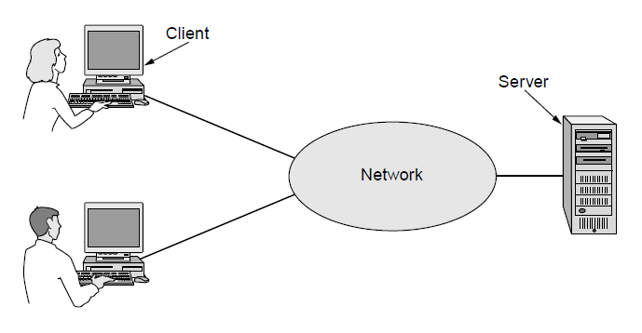
Business Applications
Resource Sharing: Goal is to make all programs, equipment, especially data available to anyone on the network without regard to the physical location of the resource or the user.
A network with two clients and one server
Even more important than sharing physical resources such as printers, and tape backup systems, is sharing information.

Slide 18
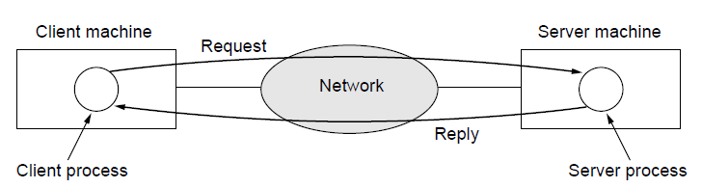
Business Applications
Provide powerful communication medium among employees. For example, e-mail, which employees generally use for a great deal of daily communication.
The client-server model involves requests and replies
IP telephony or Voice over IP (VoIP), telephone calls be carried by the computer network.

Slide 19
Business Applications
Desktop sharing: lets the remote workers see and interact with a graphical computer screen.
e-commerce (electronic commerce): customers prefer to buy airline tickets from home, shopping from home

Slide 20
Home Applications
Home users can access information, communicate with other people, and buy products and services with e-commerce.
Connecting outside of the home.
Bob Metcalfe, inventor of Ethernet, hypothesized that the value of a network is proportional to the square of the number of users because this is roughly the number of different connections that may be made. (Metcalfe’s law)

Slide 21
Home Applications
Newspapers have gone online.
Magazines and Scientific Journals, Conference Proceedings have gone online.
Much of this information is accessed using client-server model
  but there is different, popular model for accessing information that goes by the name of peer-to-peer communication (Parameswaran et al., 2001)

Slide 22
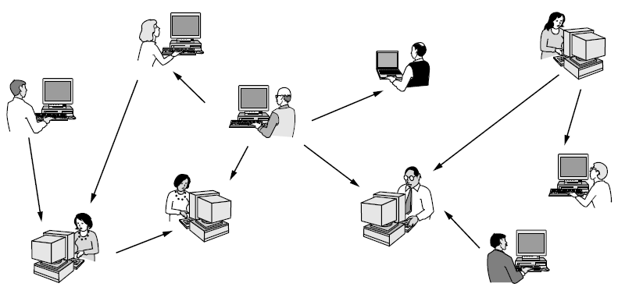
Home Applications
In a peer-to-peer system there are no fixed clients and servers.

Slide 23
Home Applications
Peer-to-Peer do not have any central database of content.
  Each user maintains his own database locally and provides a list of other nearby people who are members of the system.
  New user can then go to existing member to inspect for other names and more content.
  Used to share music and video

Slide 24
Home Applications
Social network applications, between person-to-person communications and accessing information
Groups of people can work together to create content, example, Wikipedia
Handle investments electronically

Slide 25
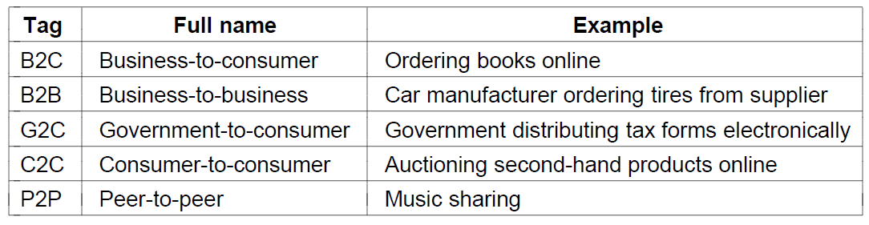
Home Applications
Some forms of e-commerce

Slide 26
Mobile Users
Want to do all of the things such as surf the Web, read and send email, watch movie that they do at home and in the office
Want to do them anywhere on land, sea or in the air
Connectivity to the Internet enables many of these mobile uses.
Cellular networks operated by telephone companies and Wireless hotspots based on the 802.11 standard are kinds of wireless network for mobile computers.

Slide 27
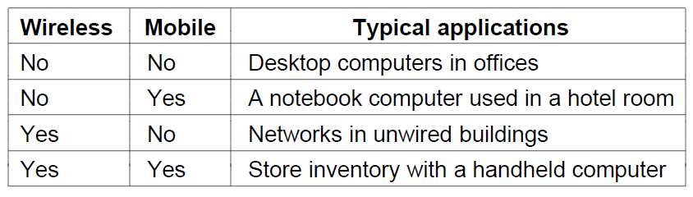
Mobile Users
Distinction between fixed wireless and mobile wireless networks
Combinations of wireless networks and mobile computing

Slide 28
Mobile Users
Convergence of telephone and the Internet
  3G and 4G cellular networks to which these mobile devices connect can provide fast services for using Internet as well as phone calls.
Geo-tagging, annotating photos and videos with the place at which they were made.
  Mobile phones are equipped with GPS (Global Positioning System) receivers.

Slide 29
Mobile Users
M-commerce, short text messages from mobiles are used to authorize payments for movie tickets
Mobile phone equipped with Near Field Communication technology can act as an RFID smartcard and interact with the nearby reader for payment.

Slide 30
Social Issues
Network neutrality
  Peer-to-peer and other content should be treated in the same way because they are just bits to the network
  The argument for communications that are not differentiated by their content or source or who is providing the content is known as network neutrality.
Digital Millennium Copyright Act
  Automated systems that search peer-to-peer networks and fire off warnings to network operators and users who are suspected of infringing copyright.
  These warnings are known as DMCA.

Slide 31
Social Issues
Profiling users
  Cookies that web browsers store on users machine
  Example: google can read your email and suggest you advertisements
Phishing
  Botnet
  Phishing messages masquerade as originating from a trustworthy party

Slide 32
Network Hardware
Personal area networks
Local area networks
Metropolitan area networks
Wide are networks
The internet

Slide 33
Network Hardware
Two types of transmission technology
    Point-to-point links
    Connect individual pairs of machines
    Go from source to destination on a network made up of point-to-point links
    Packets (or short messages) have to first visit one or more intermediate machines
    Finding good route out of multiple possible routes in point-to-point network is very important
    Point-to-point transmission with exactly one sender and exactly one receiver is sometimes called unicasting

Slide 34
Network Hardware
    broadcast links
    The communication channel in broadcast network is shared by all the machines on the network.
    Packets sent by any machine are received by all other machines.
    Intended machine responds to the sender and processes the packet, and others simply ignore it.
    Allow possibility of addressing a packet to all destinations by using a special code in the address field.
    Broadcasting, A packet is received and processed by every machine on the network
    Some broadcast systems support transmission to a subset of the machines, known as multicasting.

Slide 35
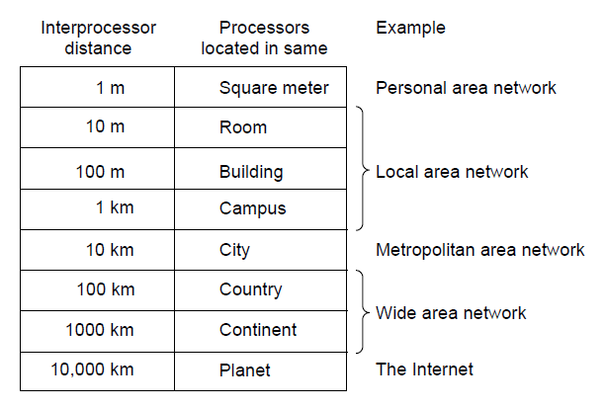
Network Hardware
Classification of interconnected processors by scale.

Slide 36
Personal Area Network
Devices communicate over the range of a person.
Short-range wireless network called Bluetooth to
connect various components without wire.
Master-slave paradigm
  Master tells the slaves what addresses to use, when they can broadcast, how long they can transmit, what frequencies they can use.
PANs can also be built with other technologies
  RFID on smartcards and library books

Slide 37
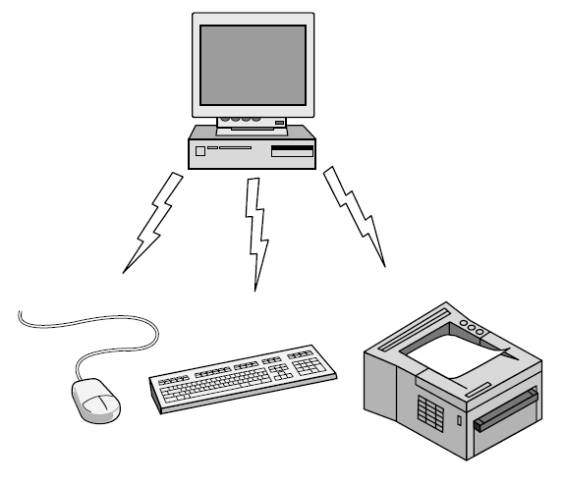
Personal Area Network
Bluetooth PAN configuration

Slide 38
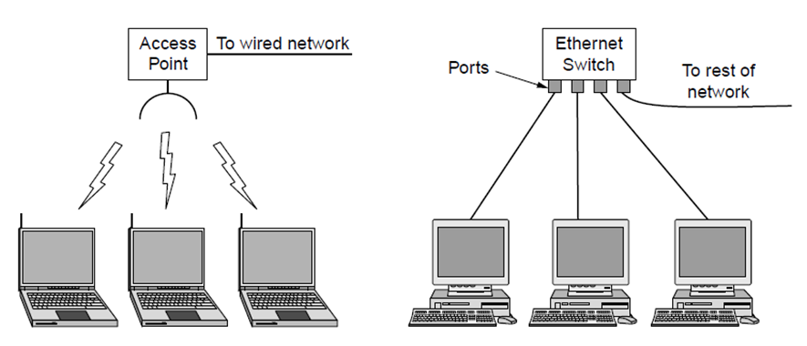
Local Area Networks
Wireless and wired LANs.
(a) IEEE 802.11
(b) Switched Ethernet.

Slide 39
Local Area Networks
Privately owned networks
Operate within and nearby single building like a home, office or factory
When LANs are used by companies, they are called enterprise networks.

Slide 40
Local Area Networks
Wireless LANs are popular because of no requirement of cable installations
Wired LANs are restricted in size, worst-case transmission time is bounded and known in advance
Runs at a speeds of 100 Mbps to 1 Gbps, have low delay and less errors.
Newer LANs upto 10 Gbps
The topology of many wired LANs is built from point-to-point links.
  IEEE 802.3, Ethernet, is very popular wired LAN
  Each computer speaks the Ethernet protocol and connects to a box called Switch with a point-to-point link (Switched Ethernet)

Slide 41
Local Area Networks
Standard for Wireless LANs called IEEE 802.11
  Popularly known as WiFi
Runs at a speeds of anywhere from 11 to 100 of Mbps

Slide 42
Local Area Networks
Possible that one large physical LAN into two smaller logical LANs.
  Example: two departments of a company might have computers on the same physical LAN but it might be easier to manage the system if both departments logically had its own network, VLAN or Virtual LAN.
  VLANs, each port is tagged with a color.
  Say red port for one department and green port for other department

Slide 43
Local Area Networks
Classic Ethernet, at most one machine could successfully transmit at a time, and a distributed arbitration mechanism was used to resolve conflicts.
  Computers transmit whenever the cable is idle
  Two or more packet collision, machines waited for random time and tried later

Slide 44
Local Area Networks
Broadcast network is divided into static and dynamic design, depending on how the channel is allocated.
Static channel allocation divide the time into discrete time slots, and use round-robin algorithm to allow each machine to broadcast.
  Wastes channel capacity when a node has nothing to say during the allotted slot.

Slide 45
Local Area Networks
Dynamic allocation
  single entity determines who goes next (centralized)
    Example, cellular base station, it might do this by accepting multiple packets and prioritizing them according to some internal algorithm
  each machine decides for itself whether to transmit (decentralized)

Slide 46
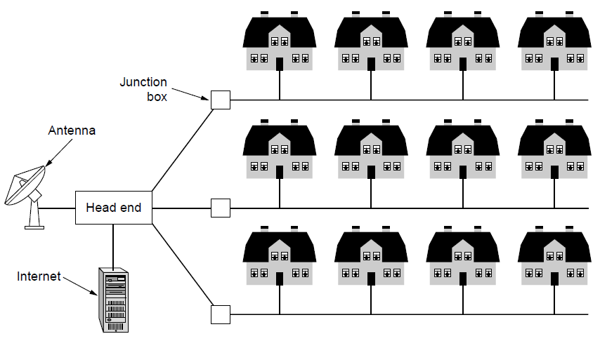
Metropolitan Area Networks
It covers a city
Example, cable TV network
Resulted in another MAN due to high speed wireless internet by IEEE 802.16, known as WiMAX.
A metropolitan area network based on cable TV.

Slide 47
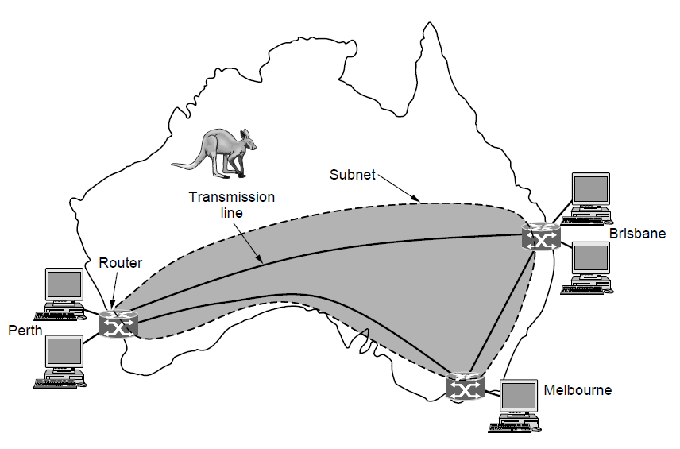
Wide Area Networks
It spans a large geographical area, often a country or continent.
WAN that connects three branch offices in Australia

Slide 48
Wide Area Networks
Subnet, collection of routers and communication lines that moved packets from source to destination host.
Subnet consists of
  Transmission lines that moves bits between machines
  Switching elements or switches
    When data arrive on an incoming line, the switching element must choose an outgoing line on which to forward them.
    Called by Routers
Network provider or telephone companies operates the subnet.

Slide 49
Wide Area Networks
Two varieties of WANs
  Virtual Private Network (VPN)
    Rather than lease dedicated transmission links
    A company might connect to Internet
    Connections to be made between the offices as virtual links that use the underlying capacity of the Internet
    Advantage of this virtualization is flexible reuse of a resource (Internet connectivity).
    Disadvantage is lack of control over the underlying resource.
  Subnet may be run by different company
    Subnet operator is known as network service provider
    Subnet operator will also connect to other networks that are part of Internet. Such operator is called an ISP (Internet Service Provider) and the subnet is an ISP network

Slide 50
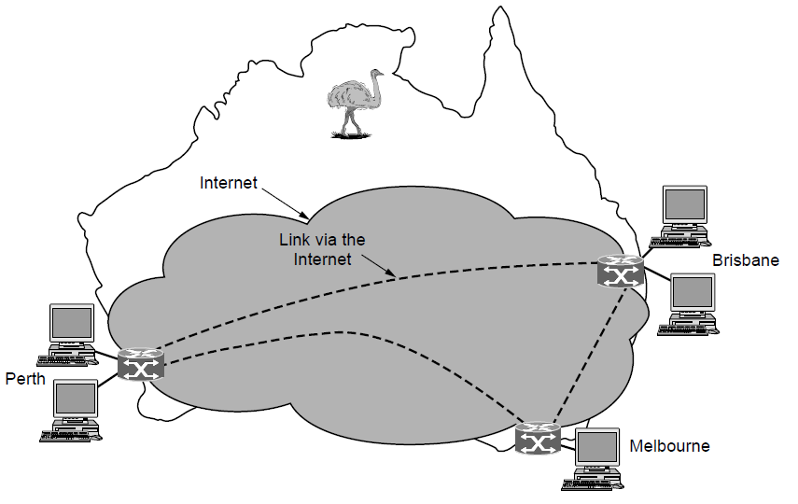
Wide Area Networks
WAN using a virtual private network.

Slide 51
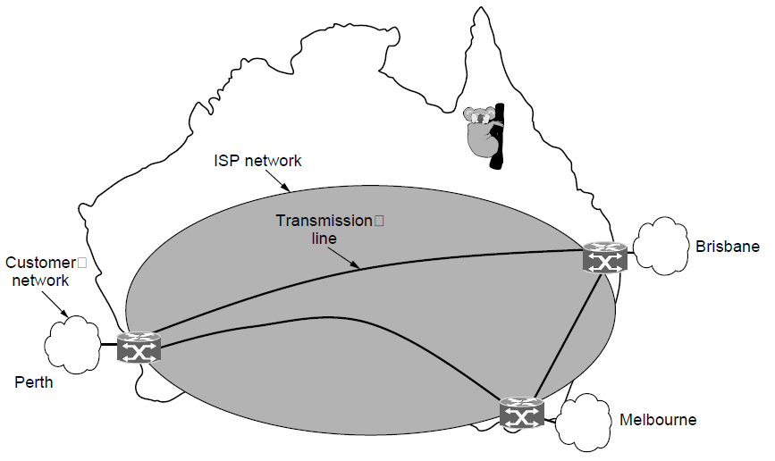
Wide Area Networks
WAN using an ISP network.

Slide 52
Wide Area Networks
If two routers are not connected by a transmission link wish to communicate, they must do this indirectly, via other routers.
  Routing algorithm is used to take decisions on which path to take to connect these two routers.
Cellular telephone network is another example of a WAN.
  Data rates of cellular networks often are on the order of 1 Mbps, much smaller than a wireless LAN (up to 100 Mbps)

Slide 53
Internetwork
We have an Internetwork, If different organizations have paid to construct different parts of the network and each maintains its part
We have an Internetwork, If the underlying technology is different in different parts (ex, wireless vs wired, broadcast vs point-to-point)
A device that connect two different networks and provides necessary translations, both in terms of hardware and software, is Gateway.

Slide 54
Reference
Computer Networks, Fifth Edition by Andrew Tanenbaum and David Wetherall, Pearson Education-Prentice Hall, 2011
Computer Network: A Systems Approach, 4th Edition by Larry L. Peterson and Bruce S. Davie, Elsevier.

